Slide 1
Lecture 7: Analytical solution of the fuel temperature profile
January 25, 2017
Michael R Tonks
Mechanical and Nuclear Engineering
Some content taken Professor Motta’s book, chapter 9

Slide 2
Today we will begin our discussion of heat transport in the fuel
Module 1: Fuel basics
Module 2: Heat transport
Intro to heat transport and the heat equation
Analytical solution of the heat equation
Numerical solution of the heat equation
1D solution of the heat equation using Matlab
2D solution of the heat equation using Matlab
Coolant temperature change, power generation, and melting
Module 3: Mechanical behavior
Module 4: Materials issues in the fuel
Module 5: Materials issues in the cladding
Module 6: Accidents, used fuel, and fuel cycle

Slide 3
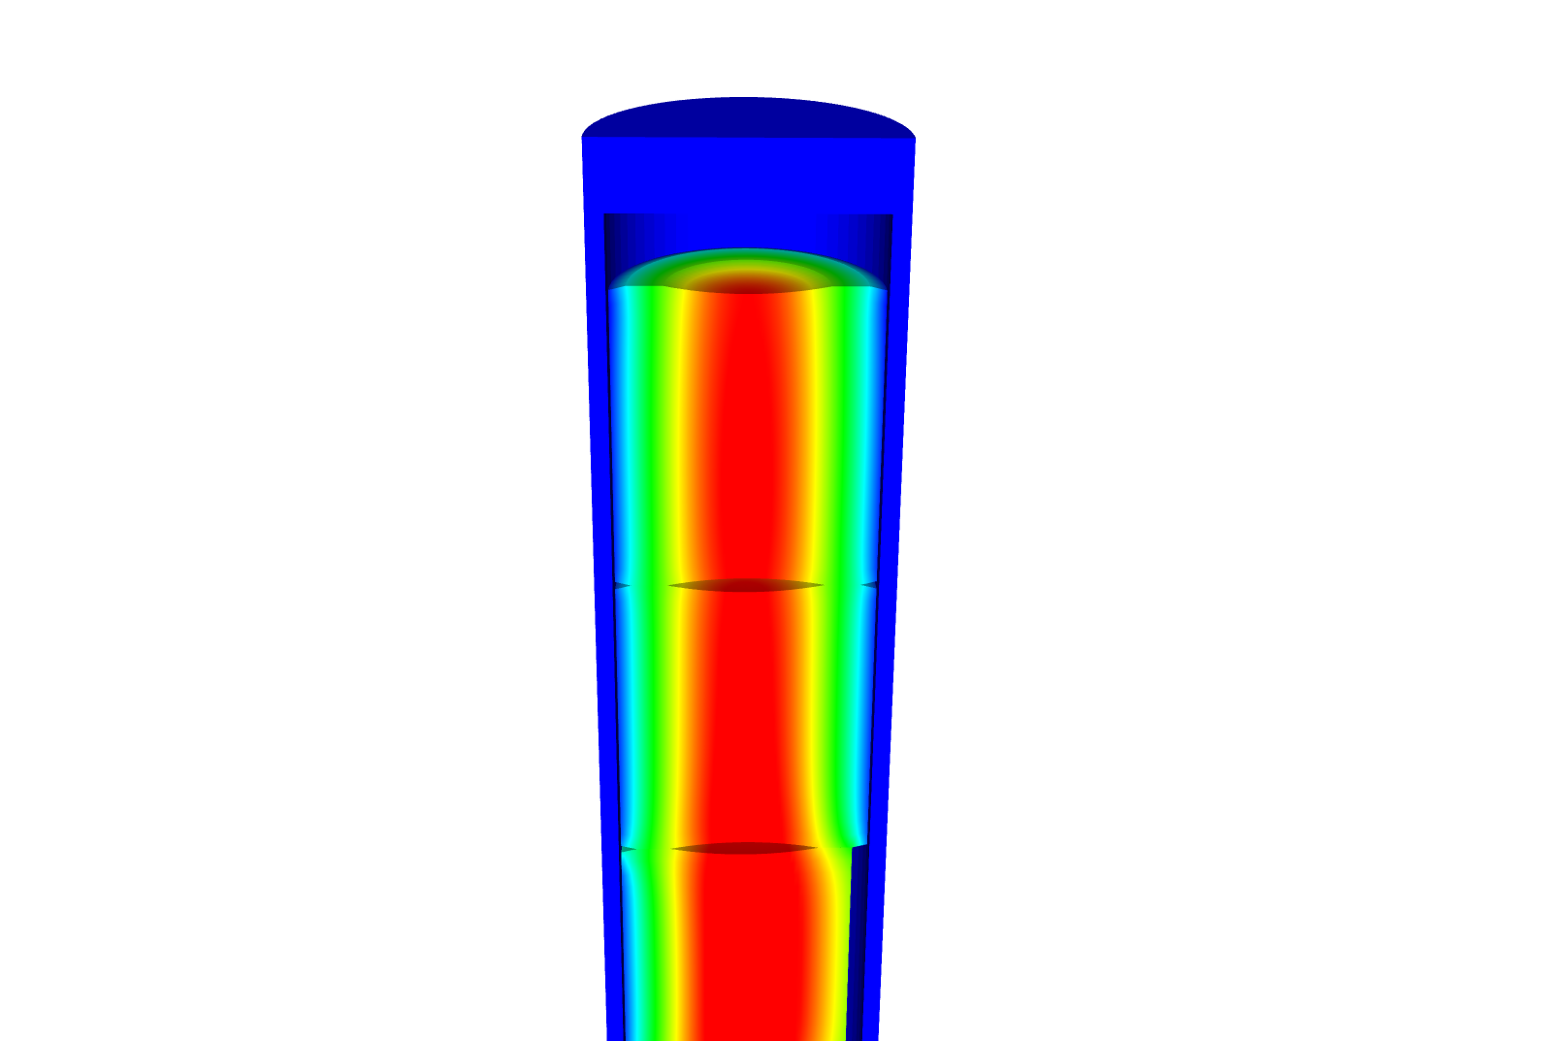
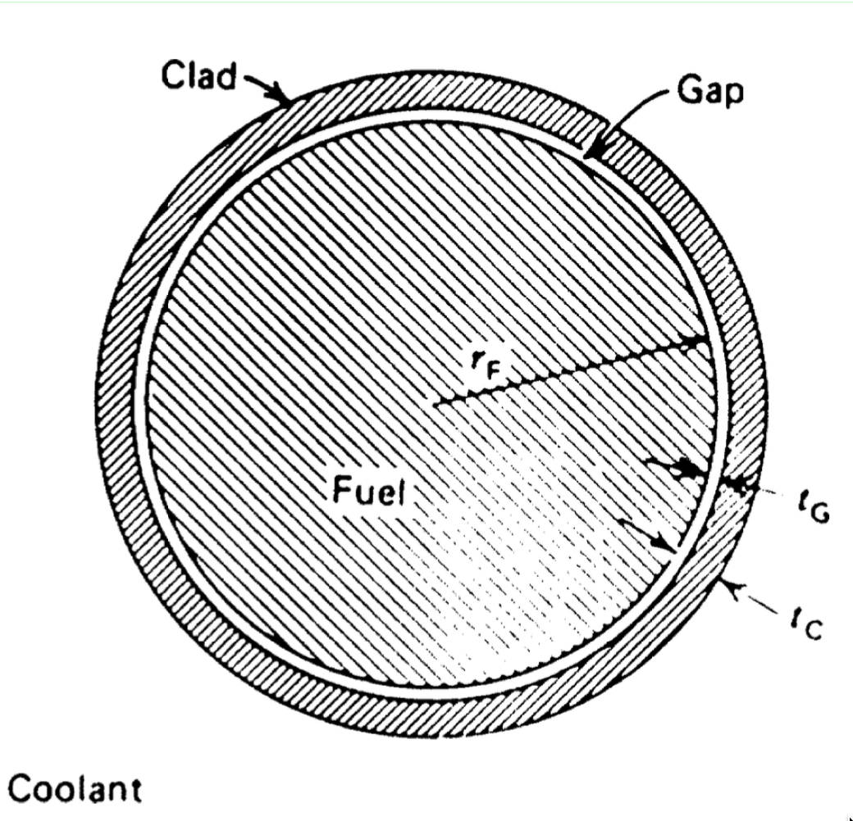
In order to solve for the temperature profile in the fuel and cladding, we make assumptions
T_{CO} T_{CI}
Assumption 1: We only care about the steady state solution
Assumption 2: The behavior is axisymmetric
Assumption 3: T is constant in z
Assumption 4: The thermal conductivity k is independent of T
T₀
T_{s}
T_{cool}
Q

Slide 4
We will start by solving for the temperature profile in the fuel
Consider the radius r = 0 in the center and r = R_{f} on the outer edge
Use the boundary conditions: T’(0) = 0, T(R_{f}) = T_{s}
Solve for the temperature T(r)

Slide 5
The linear heat rate is the heat rate delivered per unit length of fuel
LHR = πR_{f}²Q_{av} (W/cm), where Q_{av} is the radially averaged heat generation rate
If we substitue LHR into our temperature equations, we get

Slide 6
Next, we need to determine the heat transport through the gap
T_{s} T_{IC}
Fuel
clad
q_{fuel} = q_{gap}
Derive an expression to solve for T_{s} - T_{IC}
We can define the gap conductance
So,
We assume a linear temperature profile across the gap

Slide 7
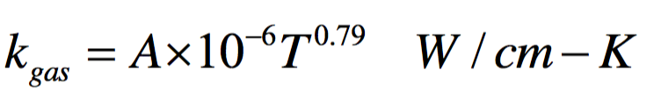

The thermal conductivity of the gap depends on the gas that is filling it
The gas can is filled with He at the beginning of life, but begins to fill with Xe due to fission gas release.
A = 16 for He and 0.7 for Xe
The fraction of Xe in the gas mixture, y, increases with time
The thermal conductivity of the mixture is determined with
Then, compute the conductance

Slide 8
Now we find the temperature change in the cladding
T_{IC} T_{OC}
Fuel
clad
q_{fc} = q_{clad}
The expression for T_{IC} – T_{OC} is

Slide 9
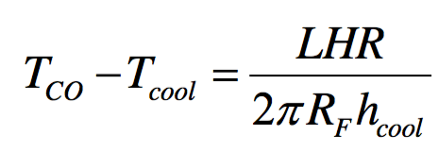
The last step is to compute the temperature change through the coolant
Heat conduction through the coolant is due to convection
h_{cool} is the convective heat transfer coefficient

Slide 10
So, to summarize the analytical temperature equations:
Note, t_{C} = δ_{c}
Inc terms of Q
In terms of LHR
Fuel:
Gap:
Cladding:
Coolant:

Slide 11
Fuel and Cladding Thermal Properties

Slide 12
To solve for the temperature profile across the radius, you first solve for the transition temperatures
You first solve for the transition temperatures.
Start from the coolant and work inward
Then, assume a linear profile everywhere except in in the fuel
Finally, solve for the temperature profile throughout the fuel
T_{CO} T_{CI}
T₀
T_{s}
T_{cool}
Q

Slide 13
Example: Calculate the temperature profile for a fuel rod using the following data:
T_{cool}=580 K; LHR = 200 W/cm; h_{cool} =2.5 W/cm²- K
Fuel pellet radius R_{F} =0.5 cm, Cladding thickness _{C}= 0.06 cm; Gap width _{gap}= 30 m
First, we calculate T_{CO} = LHR/(2 π R_{f} h_{cool}) + T_{cool} T_{CO} = 200/(2 π*0.5*2.5) + 580 = 25.5 + 580 = 605.5 K;
Then, T_{CI} = LHR _{C}/(2 π R_{f} k_{c}) + T_{CO,} where k_{c} = 0.17 W/cm-K (from table) T_{CI} = 200*0.06/(2 π*0.5*0.17) + 605.5 = 22.5 + 605.5 = 628.0 K ;
Next, T_{s} = LHR /(2 π R_{f} h_{gap}) + T_{CI,} where k_{He} = 16-e6 T_{ci}^{0.79} = 0.0026 W/cm-K h_{gap} = k_{He}/δ_{gap} = 0.0026/30e-4 = 0.87 W/cm²-K T_{s} = 200/(2 π*0.5*0.87) + 628.0 = 73.5 + 628.0 = 701.5 K ;
Finally, T₀ = LHR/(2 π k) + T_{s,} where k = 0.03 W/cm-K (from table) T₀ = 200/(4 π*0.03) + 701.5 = 530.5 + 701.5 = 1232.0 K ;

Slide 14
We finish, by calculating the temperature profile throughout the fuel

Slide 15
In class problem: Calculate the fuel centerline temperature if 30% of the gas in the gap is Xe
T_{cool}=580 K; LHR = 200 W/cm; h_{cool} =2.5 W/cm²- K
Fuel pellet radius R_{F} =0.5 cm, Cladding thickness _{C}= 0.06 cm; Gap width _{gap}= 30 m
T_{OC} = 605.5 K; T_{IC} = 628.0 K; T₀ – T_{IC} = 530.5 K
k_{He} = 0.0026 W/cm-K, k_{Xe} = 0.7e-6 T_{CI}^{0.79},
k_{Xe} = 0.7e-6 628^{0.79} = 1.36e-4 W/cm-K
k_{gap} = 0.0026^{(1-0.3)}*(1.36e-4)^{0.3} = 0.001 W/cm-K
h_{gap} = 0.001/30e-4 = 0.3386 W/cm²-K
T_{s} = 200/(2π0.5*0.3386) + 628.0 = 188.0 + 628.0 = 816.0 K
T₀ = 816.0 + 530.5 = 1346.5 K

Slide 16
Even 30% Xe in the gap has a large impact on the fuel centerline temperature

Slide 17
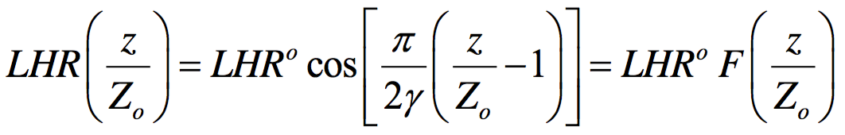

The heat generation rate varies axially, so the LHR does as well
Consider a fuel rod of length 2Z₀,
Where
LHR⁰ is the centerline linear heat rate (z = Z0)
where Z_{ex} is the extrapolation distance
γ ≈ 1.3
z = Z₀
z
z = 0

Slide 18
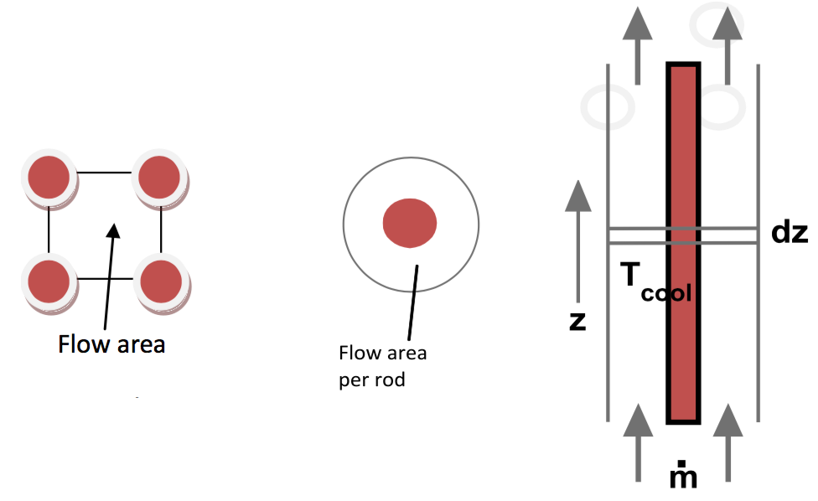
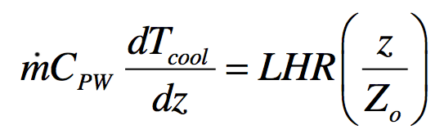
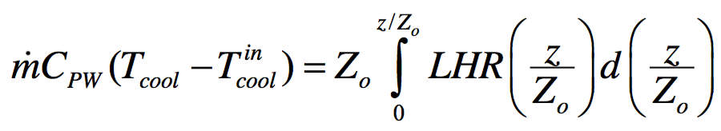
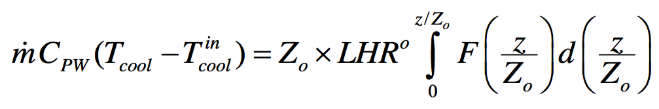
The coolant temperature actually varies with axial position along the rod
Integrating from the core entry (z = 0) to height z:
The axial power profile results in axial variation of LHR

Slide 19
Example: We will calculate the LHR and T_{cool} with axial variation
mdot = 0.25 kg/s-rod; Z₀ = 150 cm; LHR⁰ = 150 W/cm; C_{PW} = 4200 J/kg-K; T_{in} = 570 K
Plugging these values into the equations gives

Slide 20
Summary
We can derive analytical expressions for the temperature profile within a fuel rod by making four assumptions
Steady state solution
Temperature is axisymmetric
T is constant in z
The thermal conductivity is independent of temperature
The temperature profile in the fuel is parabolic.
We assume the temperature profiles in the gap, cladding, and coolant are linear

